Slide 1
JavaScript Arrays

Slide 2
JavaScript Arrays
Array Object
Creating Arrays
Indexed Arrays
Multidimensional Arrays
Iterating over an Array
Adding Element to an Array
Removing Elements from an Array
Associative Arrays
Arrays and Strings

Slide 3
Array Object
Arrays are reference types.
Array is a variable that holds multiple values.
In JavaScript all arrays are instances of global Array object (wrapper class).
length is an important property of Array

Slide 4
Creating Arrays
Arrays can be created in two ways:
Using constructors of Array (There are 3 versions of constructors)
Creating using array literal

Slide 5
Creating Arrays - Constructors
obj = new Array();
obj = new Array(arraysize);
obj=new Array(elements,…);
Examples:
var arr=new Array();
var arr=new Array(10);
var arr=new Array(“Mon”,”Tue”,”wed”);

Slide 6
Creating Arrays - Literals
var a=[“Mon”,”Tue”,”Wed”];
var b=[1,2,3,true,[“Mon”,”Tue”]];

Slide 7
Indexed Arrays
Normal arrays are indexed.
The index starts from zero.
Each item can be accessed based on its position or index in the array.

Slide 8
Indexed Arrays
var arr = [“Kevin”, “Eric” , “Jacob” , 20 , true];
document.write(arr[0]); //Kevin
document.write(arr[1]); //Eric
document.write(arr[2]); //Jacob
document.write(arr[3]); //20
document.write(arr[4); //true

Slide 9
Multidimensional Arrays
Also called as jagged arrays.
They are array of arrays.
var student = [[“Kevin”,90,”CSE”] , [“Eric”,40,”IT”] , [“Jacob”,60,”ECE”]];
document.write(student[1][0]); //Eric
document.write(student[2][2]); //ECE

Slide 10
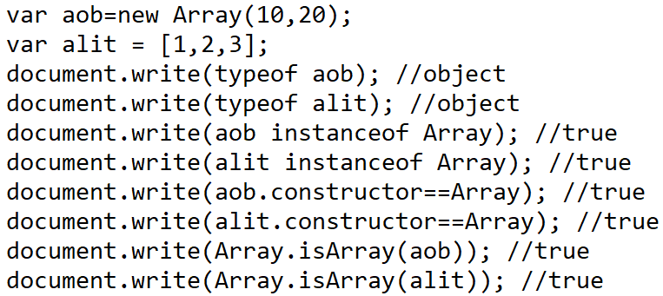
Detecting Arrays

Slide 11
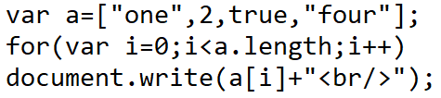

Iterating Over an Array

Slide 12
Adding Element to an Array
Using array index
Using methods of Array
push – Append an item to an array
unshift – Inserts item in the beginning of the array

Slide 13
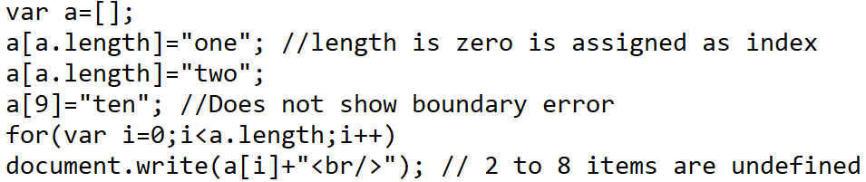

Adding Element to an Array – Using Index

Slide 14
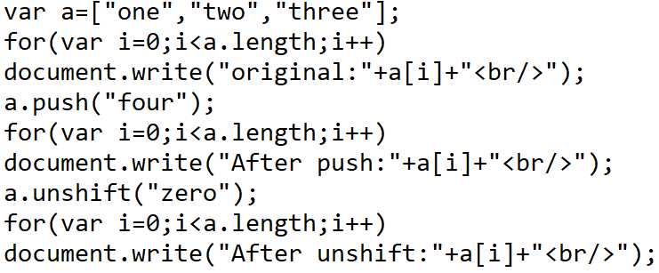
Adding Element to an Array – Using push() and unshift()

Slide 15
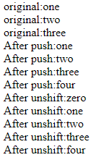
Adding Element to an Array – Using push() and unshift()

Slide 16
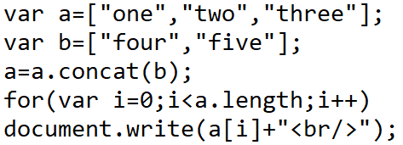

Combining Arrays – Using concat()

Slide 17
Removing Elements from an Array
Manipulating the length of the array
If the last element needs to be deleted decrement the length of the array by 1.
Using methods of Array
pop – Deletes the last element of the array
shift – Deletes the first element of the array

Slide 18
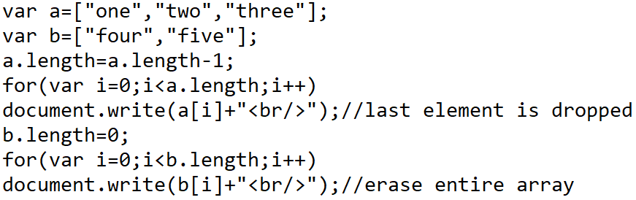
Removing Elements from an Array – Decrementing length

Slide 19
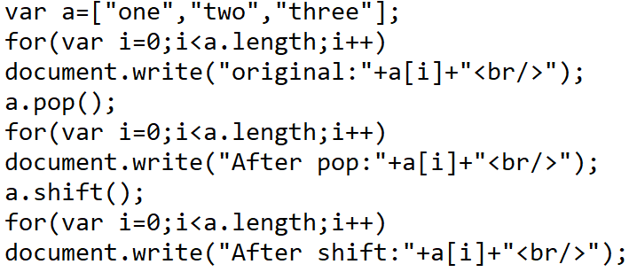
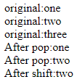
Removing Elements from an Array – pop() and shift()

Slide 20
Editing Elements of an Array
Array object provides the following methods to edit arrays
Array.slice(beginindex,[endindex])
Returns an array from the begin index to end index
If endindex not specified returns till the end of the array
If the index is negative perform slicing in reverse
Does not modify original array
Array.splice(index,deletecount,[element0,…,elementn])
Returns the array by extracting elements from index to deletecount
deletecount – is not index but the number of elements to be deleted from the index
Optional elements are the elements to be replaced in the positions where the original elements were removed
Modifies the original array

Slide 21
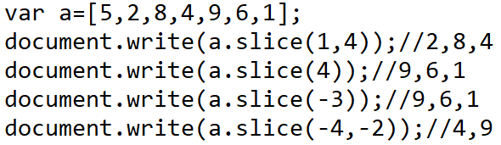
Extracting Elements of an Array – slice()

Slide 22
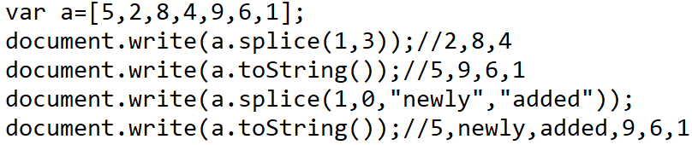
Editing an Array – splice()

Slide 23
Associative Arrays
Associative arrays are arrays with key/value pairs.
It does not have numeric index.
The keys are used to access or modify the values.
var stud={“regno”:”19MIA1234”,”name”:”kevin”}
regno and name are keys
19MIA1234 and Kevin are respective values

Slide 24
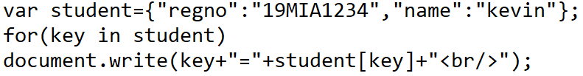

Associative Arrays
Associative arrays do not support length property.
Hence we use a for..in loop

Slide 25
Arrays as Reference Types
Arrays are reference types.
Hence if we create an array the variable holds the reference or memory address of that array.
If we copy this array the new array will also hold the same address.
Hence any changes done in the new array will affect the original array and vice versa.

Slide 26
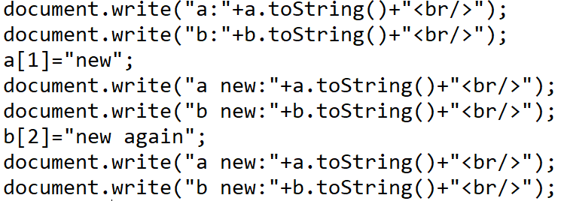
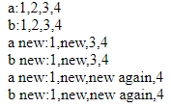
Arrays as Reference Types

Slide 27
Arrays and Strings
String.split(); - Returns an array by splitting the string into tokens based on delimiter
Array.join(); - joins the elements of an array by placing the delimiters alternative to elements

Slide 28
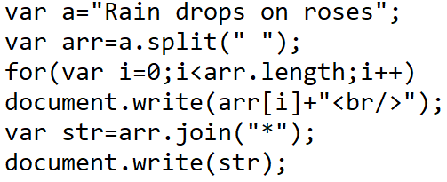
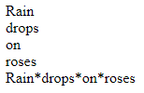
split() and join()

Slide 29
REFERENCE
Alexei White, JavaScript Programmer’s Reference, Wrox, ISBN:978-81-265-2363-4

